Slide 1
Machine Learning Introduction
With Linear Regression

Slide 2
Why?
Benefits from machine learning
Recognise everything (text, speech, images)
Predictions (medical prediction and diagnostic)
Detection (spam)
Create a bubble for you (Netflix, YouTube, …)
Learn a car to drive, drone to fly, robot to walk
….. etc!

Slide 3
Introduction
What is machine learning (basics)
Trainings set with real data (supervised learning)
Algorithm with an initial set of parameters
Train (optimise) the algorithm
Predict outcome for a new case (not in the trainings set)

Slide 4
Video Time
https://www.youtube.com/watch?v=opsmd5yuBF0

Slide 5
Our workshops
What machine learning we are going to do?
Han: Linear regression (with one feature)
Eric: Logistic regression (aka classification)
Merlin: Neural Networks (the magic!)

Slide 6
Linear Regression
What is linear regression => predict outcome from input, using a linear model

Slide 7
Terms in Linear Regression
trainingsset => real live examples (input and output are known)
m => size of the trainingsset
model => your algorithm to predict the output from input (y = a + b * x)
feature => x (for example skull radius)
cost => total error of the model based on the trainingsset
gradient descent => method to increase the accuracy of the model (minimise cost)
learning rate => number that influences the speed the model learns (or not!)

Slide 8
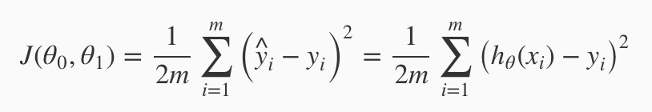
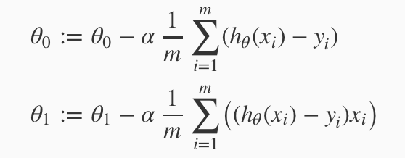
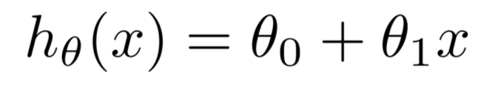
Some math involved
Cost
Train
Hypothesis

Slide 9
Relax Time
https://www.youtube.com/watch?v=rksCTVFtjM4

Slide 10
We take it slow
Linear regression with one feature and one prediction (y = a + b * x)
Program in peers (front-end knowledge!!)
If you are afraid of math, look for somebody who isn’t (or pretends he isn’t)
Use Javascript (keep it simple!)
Step by step
Visualise everything (https://plot.ly/javascript/, & https://plot.ly/javascript/line-and-scatter/)
Presentation at 4:30h

Slide 11
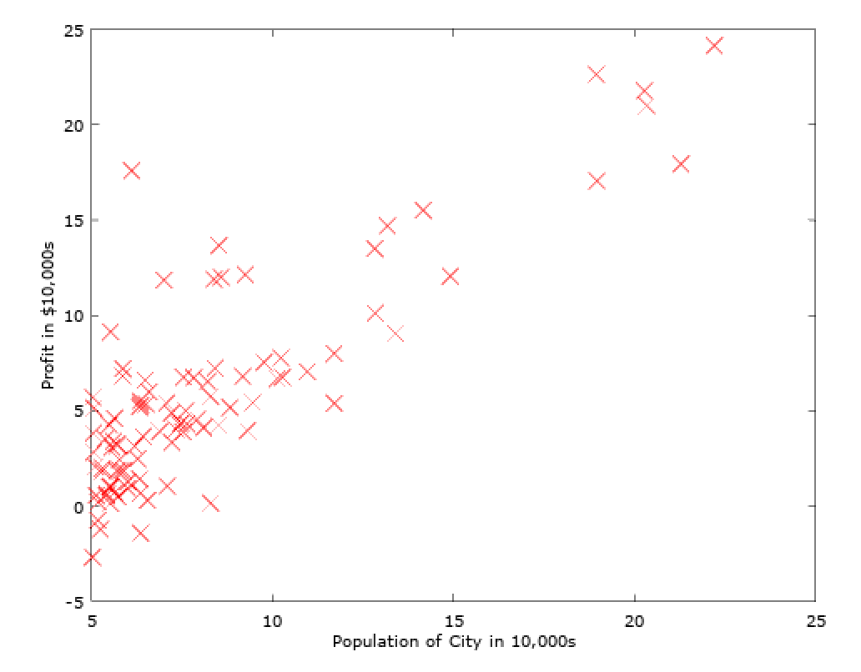
Step 1 - The trainingsset
Load the food truck trainingsset
It contains two columns; population and profit
Each row concerns the data for 1 city
Columns are separated by a comma
Numbers contain “thousand separator”
Put the population in variable X and the profit in y
Visualise the trainingsset
x -> population
y -> profit
use 1000-scale

Slide 12
Step 2 - The Cost function
Choose the initial weights of the model
Weights == parameters == a & b == theta0 (Θ0) & theta1 (Θ1)
Use “theta0” (b) and “theta1” (a) as your variable names
Choose initial weights for theta0 & theta1 randomly between -5 and 5
Visualise h(x) = theta0 + theta1 * x in the graph of step 1 (should be a straight line)
Create the cost function J (with your initial weights Θ0 & Θ1)
h(x) = a + b * x = Θ0 + Θ1 * x => (hypothesis or prediction)
The cost for the whole trainingsset is J =>
Calculate the cost J for the whole trainingsset
Remember: m is de number of training examples (rows) in the trainingsset
Visualise the cost for the trainingsset (with your initial weights Θ0 & Θ1)
Show the cost, theta0 and theta1 in the graph from step 1 (somewhere to the right and bottom of the graph as plain numbers)
No worries!
It’s just a for loop

Slide 13
Step 3 - Gradient descent (1/2)
Choose the learning rate
Use “alpha” as your learning rate variable
Choose alpha 0,01 (you can choose another after all is done from 0,001 / 0,003 / 0,01 / 0,03 / 0,1 / 0,3 / 1 / 3 to play with speed and accuracy of this step)
Show the learning rate in the graph (where you also show cost, theta0 and theta1)
Create the gradient descent algorithm
Create a function to calculate new values for theta0 and theta1 based on the gradient descent math:
Important; update theta0 and theta1 simultaneously; theta0 and theta1 to the right of := are the old theta values
No worries!
Just for loops again

Slide 14
Step 3 - Gradient descent (2/2)
Let the learning begin
Train your algorithm by calling the gradient descent function 1500 times and so recalculating theta0 and theta1 with each iteration
Visualise the updated algorithm after every 50 steps by drawing the updated line in the graph => h(x) = theta0 + theta1 * x (or y = theta0 + theta1 * x). Pause every 50 steps a couple of hundred milliseconds so the updates in the graphs are visible.
Show the new values for theta0 and theta1 after every 50 steps in the graph as well
After every 50 steps, recalculate the cost (J) of the model and show this in the graph as well
Visual the decreasing cost of the model (your algorithm) (optional)
Create a graph that visualises the cost (x axis) versus number of iterations (y axis)

Slide 15
Step 4 - Predict
Predict the profit for two test cases
Use the hypothesis function h(x) and your optimised theta0 ad theta1
Predict the profit for two test cases en check outcome:
For population = 35,000, predict a profit of 4519.767868
For population = 70,000, predict a profit of 45342.450129
You are done and I am super proud (and so should you be) !!!

